Slide 1
Entity Framework Core

Slide 2
WHAT IS ENTITY FRAMEWORK CORE
EF is an ORM tool that helps us to perform DB Operations
Entity Framework (EF) Core is a lightweight,extensible, open source and cross-platform version of the popular Entity Framework data access technology.

Slide 3
Overview of ORM
Most ORMs lets you define the table structure in code and you can map a class so that it corresponds to a table. The columns are simply properties on the class. Depending on the ORM several approaches are possible
Using an ORM is about beeing faster, more productive and about knowing exactly what goes into a database.

Slide 4
Database Approach
Entity Framework's Database First approach allows developers to build software applications from their existing databases. You connect to an exisitng database and Visual Studio and EF build a data object model and the complete application for you with very little code.
It creates model codes (classes, properties, DbContext etc.) from the database in the project and those classes become the link between the database and controller
DB first is better upgrading when an existing application and The Database First Approach creates the entity framework from an existing database.

Slide 5
Code First Approach
In the Code-First approach, you focus on the domain of your application and start creating classes for your domain entity rather than design your database first and then create the classes which match your database design.
Code first is recommended approach for new applications
Create or update the database schema using automated migration or code-based migration

Slide 6
Introduction of Repository Pattern
A Repository pattern is a design pattern that mediates data from and to the Domain and Data Access Layers ( like Entity Framework Core / Dapper).
Repositories are classes that hide the logics required to store or retreive data
Thus, our application will not care about what kind of ORM we are using, as everything related to the ORM is handled within a repository layer.
This allows you to have a cleaner seperation of concerns.
Repository pattern is one of the heavily used Design Patterns to build cleaner solutions.

Slide 7
Benefits of Repository Pattern
Reduce Dupliacate Queries: imagine having to write lines of code to just fetch some data from your datastore. Now what if this set of queries are going to be used in multiple places in the application. Not very ideal to write this code over and over again, right? Here is the added advantage of Repository Classes. You could write your data access code within the Repository and call it from multiple Controllers / Libraries.
De-couples the application from the Data Access Layer: There are quite a lot of ORMs available for ASP.NET Core. Currently the most popular one is Entity Framework Core. But that change in the upcoming years. To keep in pace with the evolving technologies and to keep our Solutions upto date, it is highly crucial to build applications that can switch over to a new DataAccessTechnology with minimal impact on our application’s code base

Slide 8
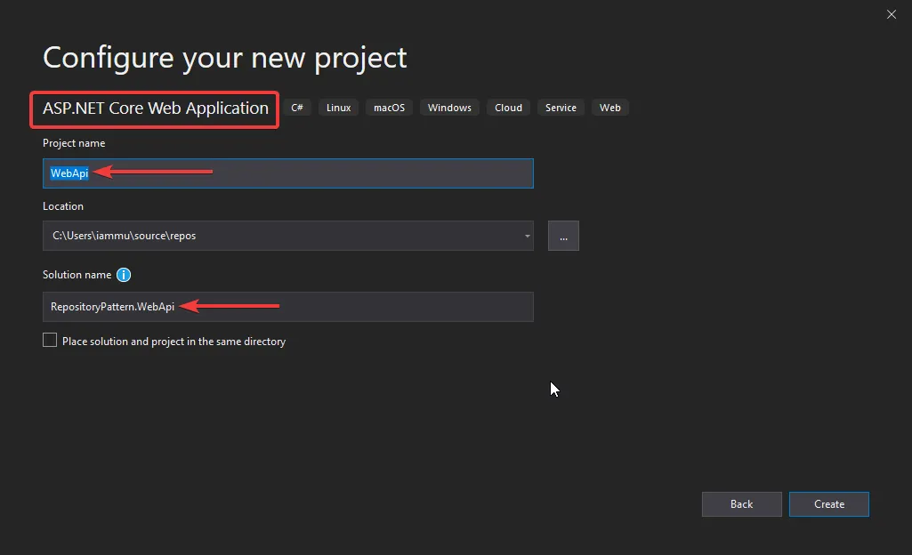
Implementing Repository Pattern
Let’s implement Repository Pattern in an ASP.NET Core WebApi Project. What seperates this guide from the others is that we will also be working with a Clean Architecture in mind to demonstrate the real-life implementation.
Let’s start by creating a new Solution. Here I am naming my Solution as Repository Pattern. WebApi and the first project as WebApi (ASP.NET Core).

Slide 9
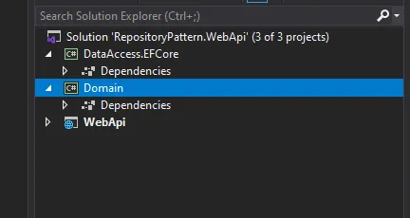
Simalary, let’s add 2 more .NET Core Class Library Projects within the solution. We will call it DataAccess.EFCore and Domain. Here are the features and purposes of each project.
Domain – Holds the Entities and Interfaces. It does not depend on any other project in the solution.
DataAccess,EFCore – Since we will be using Entity Framework Core – Code First Apporach to interact with our Database, let’s build a project that solely represents everything related to EFCore. The aim is that, later down the road one can easily build another Data Access layer like
DataAccess.Dapper or so. And our application would still support it. Here is where Dependency Inversion comes to play.
WebApi – This is like the presentation layer of the entire solution. It depends on both the projects.
Here is how our Solution would look like now.

Slide 10
Setting up the Entities and EFCore
Now, let’s add the Required Entities to the Domain Project. Create a new Folder in the Domain Project named Entities.
Create 2 very simple classes – Developer and Project under the Entities Folder.
Next , we will setup and configure Entity Framework Core. Install these Required Packages in the DataAccess.EFCore Project. Here is where we would have our DbContect Class and the actual Implementations of the Repositories.
Add a reference to the Domain Project (where we have defined our entities) and create a new Class in the DataAccess.EFCore Project and Name it ApplicationContext.cs.
Once our Data Access Layer is done, let’s move to the WebApi Project to register EFCore within the ASP.NET Core Application. We will also update the database in this step to accomadate the Developer and Project Table
Install-Package Microsoft.EntityFrameworkCore
Install-Package Microsoft.EntityFrameworkCore.SqlServer

Slide 11
Firstly, Install this package on the WebApi Project. This allows you to run EF Core commands on the CLI.
Next, Navigate to Startup.cs or(program.cs) and add this line to Register the ApplicationContext class that we created. Note that you will have to add a refernce of the DataAccess.EFCore Project to the WebApi Project.
After that, open up the appsettings.json file in the API Project and add the connection string
Finally, Let’s update the database. Open your Package Manager Console on Visual Studio and run the following commands.
Install-Package Microsoft.EntityFrameworkCore.Tools
services.AddDbContext<ApplicationContext>(options =>
options.UseSqlServer(
Configuration.GetConnectionString("DefaultConnection"),
b => b.MigrationsAssembly(typeof(ApplicationContext).Assembly.FullName)));
"ConnectionStrings": { "DefaultConnection": "<your connection string>", },
add-migration Initial update-database

Slide 12
Using LINQ to Entities to perform CRUD operations
Step 1
Create the Entity Customer Class
Step 2
Create using LINQ
Create Data Context
Set the Data for Insert
Do an In-memory Update
Do the Final Physical Commit
The Final Create LINQ Code
Step 3
Update using LINQ
Create Data Context
Select the Customer LINQ Object which we Want to Update
Finally Set New Values and Update Data to Physical Database
The Final Code of LINQ Update
Step 4
Delete using LINQ
DeleteOnSubmit

Slide 13
SQL Query Logging
We often need to log the SQL and change tracking information for debugging purposes in EF Core.
Entity Framework Core integrates with the .NET Core logging to log SQL and change tracking information to the various output targets. First, install the NuGet package for logging provider of your choice and then tie up the DbContext to ILoggerFactory.
Let's install the logging provider's NuGet package. Here, we will display the logs on the console, so install the Microsoft.Extensions.Logging.Console NuGet package from the NuGet Package Manager or execute the following command in the Package Manager Console:
PM> Install-Package Microsoft.Extensions.Logging.Console

Slide 14

Migration & Database Update
Migration is a way to keep the database schema in sync with the EF Core model by preserving data.
The following Table lists important migration commands in EF Core.
PMC Command | dotnet CLI command | Usage
add-migration <migration name> | Add <migration name> | Creates a migration by adding a migration snapshot.
Remove-migration | Remove | Removes the last migration snapshot.
Update-database | Update | Updates the database schema based on the last migration snapshot.
Script-migration | Script | Generates a SQL script using all the migration snapshots.

Slide 15
Eager Loading Vs Explicit Loading Vs Lazy Loading
Lazy Loading:- By Default Linq support lazy loading. in this techniq the Child objects are not loaded automatically with Parent object. until they are requested. var query = context.Employees.Take (4); // Lazy loading
Eager Loading:- in case of eager loading the child objects are loaded automatically with parent object. if we want to use eager loading then we need to use Include method. var query = context.Employees.Include(“Products”).Take(4); // Eager loading
Explicit Loading:- when lazy loading is turn off. we can also load related entites by explicit calling by load method. dbContext.Entry(usr).Reference(usr => usr.UserDetails).Load();

Slide 16
Raw SQL And Stored Procedures
DbSet.FromSql()
Entity Framework Core provides the
method to execute raw SQL queries for the underlying database and get the results as entity objects.
The following example demonstrates executing a raw SQL query to MS SQL Server database.
Here, you will learn how to execute the database stored procedure in Entity Framework Core.
EF Core provides the following methods to execute a stored procedure:
var context = new SchoolContext(); var students = context.Students .FromSql("Select * from Students where Name = 'Bill’”)
.ToList();
DbSet<TEntity>.FromSql()
DbContext.Database.ExecuteSqlCommand()

Slide 17

Thank you

